Slide 1
JavaScript 2: Using JavaScript
Chapter 9

Slide 2
Chapter 9
1
The Document Object Model (DOM)
2
Modifying the DOM
3
Events
4
Event Types
5
Forms
6
Summary

Slide 3
Chapter 9
1
The Document Object Model (DOM)
2
Modifying the DOM
3
Events
4
Event Types
5
Forms
6
Summary

Slide 4
The Document Object Model (DOM)
Overview

Slide 5
The Document Object Model (DOM)
Nodes and NodeLists

Slide 6
The Document Object Model (DOM)
Document Object
The DOM document object is the root JavaScript object representing the entire HTML document
// retrieve the URL of the current page
var a = document.URL;
// retrieve the page encoding, for example ISO-8859-1
var b = document.inputEncoding;

Slide 7
The Document Object Model (DOM)
Selection Methods
Classic
getElementById()
getElementsByTagName()
getElementsByClassName()
Newer
querySelector() and
querySelectorAll()

Slide 8
The Document Object Model (DOM)
Selection Methods

Slide 9
The Document Object Model (DOM)
Query Selector

Slide 10
The Document Object Model (DOM)
Element Node Object
Element Node object represents an HTML element in the hierarchy, contained between the opening <> and closing </> tags for this element. Every node has
classList
className
Id
innerHTML
Style
tagName

Slide 11
The Document Object Model (DOM)
More common (not universal) properties
href
name
src
value

Slide 12
Chapter 9
1
The Document Object Model (DOM)
2
Modifying the DOM
3
Events
4
Event Types
5
Forms
6
Summary

Slide 13
Modifying the DOM
Changing an Element’s Style

Slide 14
Modifying the DOM
Meet the family

Slide 15
Modifying the DOM
Changing an Element’s Content
document.getElementById("here").innerHTML = "foo<em>bar</em>";

Slide 16
Modifying the DOM
Creating DOM elements

Slide 17
Modifying the DOM
Creating DOM elements

Slide 18
Modifying the DOM
Tools - Debuggers

Slide 19
Modifying the DOM
Tools – Performace checkers

Slide 20
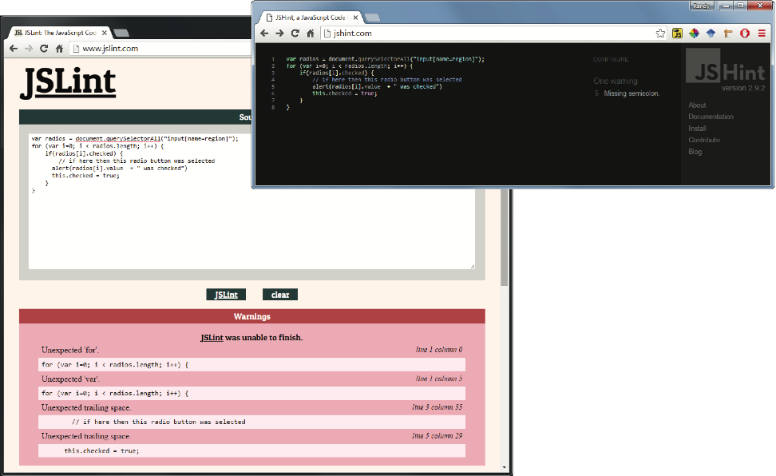
Modifying the DOM
Tools – Linters

Slide 21
Chapter 9
1
The Document Object Model (DOM)
2
Modifying the DOM
3
Events
4
Event Types
5
Forms
6
Summary

Slide 22
Events
JavaScript event is an action that can be detected by JavaScript
Many of them are initiated by user actions
some are generated by the browser itself.
We say that an event is triggered and then it is handled by JavaScript functions

Slide 23
Events
Event-Handling Approaches – Inline Hook

Slide 24
Events
Event-Handling Approaches – Event Property Approach
var myButton = document.getElementById('example');
myButton.onclick = alert('some message');

Slide 25
Events
Event-Handling Approaches – Event Listener Approach
var myButton = document.getElementById('example');
myButton.addEventListener('click', alert('some message'));
myButton.addEventListener('mouseout', funcName);

Slide 26
Events
Event-Handling Approaches – Event Listener Approach (anon function)
myButton.addEventListener('click', function() {
var d = new Date();
alert("You clicked this on "+ d.toString());
});

Slide 27
Events
Event Object
When an event is triggered, the browser will construct an event object that contains information about the event.
div.addEventListener('click', function(e) {
// find out where the user clicked
var x = e.clientX;
…

Slide 28
Events
Event Object
bubbles Indicates whether the event bubbles up through the DOM
cancelable Indicates whether the event can be cancelled
target The object that generated (or dispatched) the event
type The type of the event (see Section 9.4)

Slide 29
Chapter 9
1
The Document Object Model (DOM)
2
Modifying the DOM
3
Events
4
Event Types
5
Forms
6
Summary

Slide 30
Event Types
Mouse Events
click The mouse was clicked on an element
dblclick The mouse was double clicked on an element
mousedown The mouse was pressed down over an element
mouseup The mouse was released over an element
mouseover The mouse was moved (not clicked) over an element
mouseout The mouse was moved off of an element
mousemove The mouse was moved while over an element

Slide 31
Event Types
Keyboard Events
keydown The user is pressing a key (this happens first)
keypress The user presses a key (this happens after keydown)
keyup The user releases a key that was down (this happens last)

Slide 32
Event Types
Touch Events
Touch events are a new category of events that can be triggered by devices with touch screens
Limited Browser support (2017)
The different events (e.g., touchstart, touchmove, and touchend) are analogous to some of the mouse events (mousedown, mousemove, and mouseup).

Slide 33
Event Types
Form Events
Blur
Change
Focus
Reset
select
Submit

Slide 34
Event Types
Frame Events
abort An object was stopped from loading
error An object or image did not properly load
load When a document or object has been loaded
resize The document view was resized
scroll The document view was scrolled
unload The document has unloaded

Slide 35
Chapter 9
1
The Document Object Model (DOM)
2
Modifying the DOM
3
Events
4
Event Types
5
Forms
6
Summary

Slide 36
Forms
Responding to Form Movement Events

Slide 37
Forms
Responding to Form Changes Events

Slide 38
Forms
Validating a Submitted Form
Field Validation
Number Validation
Other (non JavaScript) Form validation reminder

Slide 39
Forms
Submitting Forms
var formExample = document.getElementById("loginForm");
formExample.submit();

Slide 40
AJAX
First the Normal Request Response Loop

Slide 41
AJAX
The problem

Slide 42
AJAX
The solution

Slide 43
Chapter 9
1
The Document Object Model (DOM)
2
Modifying the DOM
3
Events
4
Event Types
5
Forms
6
Summary

Slide 44
Summary
Key Terms
blur
Document Object Model
(DOM)
document root
DOM document object
DOM tree
element node
event
event bubbling
event delegation
event handler
event listener
event object
event propagation
event type
focus
form events
frame events
keyboard events
linter
mouse events
node
selection methods
touch events

Slide 45
Summary
Questions?

